Slide 1


Name: Christo Tonio
SkillsBuild Email ID: christo_tonio@srmap.edu.in
College Name: SRM UNIVERSITY AP, AMARAVATI
College State: ANDHRA PRADESH
Internship Domain : Artificial Intelligence
Internship Start Date and End Date: 3rd June 2024 – 25th July 2024

Slide 2
Project title :Employee Burnout predictor
Employee burnout is a significant problem in today's fast-paced work environment, and developing a predictor for it could be transformative. As a college student studying computer science, I believe that using machine learning to forecast burnout could enable companies to identify employees at risk and intervene early. By examining factors such as job satisfaction, work-life balance, workplace social support, and access to mental health resources, we can train a model to detect early signs of burnout. This proactive approach could enhance employee well-being, increase productivity, and decrease turnover rates. It's exciting to consider how technology can positively impact people's lives and foster healthier workplaces.

Slide 3
AGENDA
Project Title: Employee Burnout Prediction using linear regression
Data Cleaning
Data Preprocessing
Correlation techniques to know which features are best for predicting target variable
One-hot encoding
Linear Regression
Performance metrics

Slide 4
PROJECT OVERVIEW:
Identifying Key Factors:
Analyze the elements that contribute to burnout, such as excessive workload, lack of control, poor work-life balance, insufficient support, unclear job expectations, negative workplace culture, lack of recognition, poor working conditions, and high emotional demands.
Data Collection and Analysis:
Gather pertinent data on these factors through employee surveys, performance metrics, and health records. Prepare and clean the data to ensure its accuracy and reliability for analysis.
Machine Learning Model Development:
Choose suitable machine learning algorithms. Train and test the model using the prepared data to accurately predict burnout risk.
Monitoring and Evaluation:
Establish mechanisms for the continuous monitoring and evaluation of the predictor’s performance to ensure its effectiveness and reliability.

Slide 5
Objectives
The primary goals are to create a highly effective linear regression model for employee burnout prediction and include appropriate information sources. The study is to enable early detection of possible burnout cases and identify important factors of burnout, such as job role and mental exhaustion. This will support plans to improve overall employee well-being and productivity, enable quick and efficient measures, and offer practical suggestions for organizational improvements.

Slide 6
Who are the end users of this project?
Human Resources (HR) Professionals
HR teams will use the predictor to identify employees at risk of burnout, enabling them to implement targeted interventions and support measures.
Managers and Team Leaders
Managers and team leaders will gain valuable insights from the predictor to better understand their team’s well-being, allowing them to adjust workloads or provide additional support as needed.
Employees
Employees will have access to the tool to self-assess their own risk of burnout, empowering them to seek help or adjust their work habits proactively.
Organizational Leaders
Senior executives and decision-makers will use aggregated data from the predictor to make informed decisions regarding organizational policies and wellness programs.

Slide 7
YOUR SOLUTION AND ITS VALUE PROPOSITION
Accurate Predictions: Logical regression offers precise predictions of employees at risk of burnout, enabling proactive measures.
Data-Driven Decision Making: Leveraging logical regression ensures interventions are based on robust data analysis, leading to more effective and targeted actions.
Enhanced Employee Well-being: Early identification of burnout risks facilitates timely support, improving employee well-being, job satisfaction, and overall morale.
Resource Optimization: The model optimizes resource allocation by pinpointing employees who need support the most, ensuring efficient use of organizational resources.
Improved Retention and Productivity: Proactively addressing burnout reduces turnover rates and boosts productivity, fostering a healthier and more productive work environment

Slide 8
Value Proposition Points
Early Detection: Give timely interventions by predicting employee burnout.
Data-Driven Insights: Make exact observations about workers' well-being by utilizing cutting-edge machine learning methods.
Increased Productivity: Actively treat burnout to improve employee happiness and productivity.
Decreased Turnover: By managing burnout well, reduce the rate of employees turnover.

Slide 9
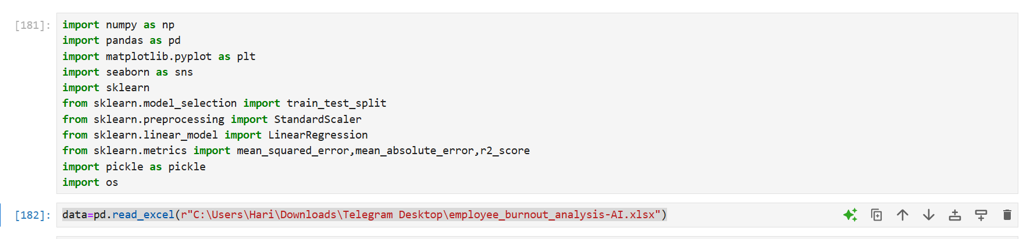
The Libraries used for the project:

Slide 10
Libraries used:
NumPy: NumPy (Numerical Python) is a fundamental library for numerical computing in Python. It provides support for arrays, matrices, and a wide range of mathematical functions to operate on these data structures.
Key Features: Efficient array operations, mathematical functions,
Pandas: Pandas is a powerful data manipulation and analysis library. It provides data structures like Data Frames and Series, which make it easy to handle and analyze large datasets.
Key Features: Data cleaning, manipulation, and analysis; handling of missing data; and support for various file formats like CSV, Excel, and SQL databases
Matplotlib: Matplotlib is a plotting library for creating static, interactive, and animated visualizations in Python. It is highly customizable and works well with NumPy and Pandas.
Key Features: Creation of various types of plots such as line graphs, scatter plots
Seaborn: Seaborn is a statistical data visualization library built on top of Matplotlib. It provides a high-level interface for drawing attractive and informative statistical graphics.
Key Features: Built-in themes and color palettes; easy creation of complex visualizations like heatmaps
Scikit-Learn (sklearn):Scikit-Learn is a comprehensive machine learning library that provides simple and efficient tools for data mining and data analysis. It supports various supervised and unsupervised learning algorithms
Key Features: Classification, regression, clustering, dimensionality reduction, model selection, and preprocessing; integration with NumPy and Pandas..
Pickle: Pickle is a module in Python used for serializing and deserializing Python objects. It allows you to save objects to a file and load them back into memory, which is useful for saving machine learning models or other data structures

Slide 11
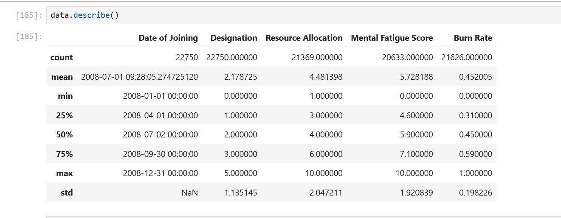
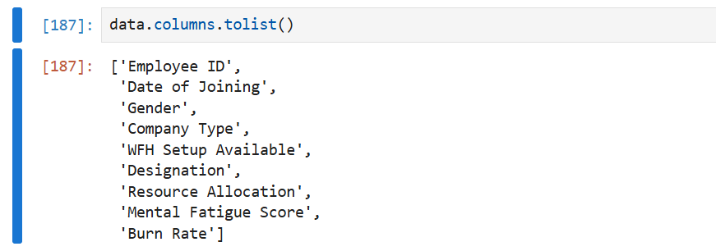
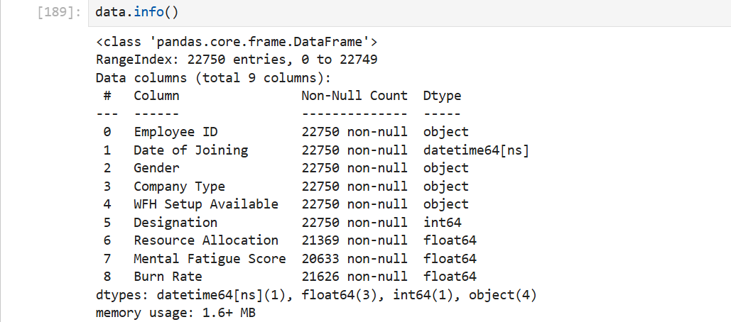
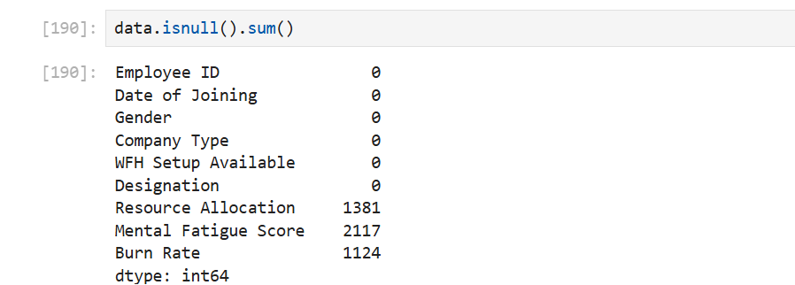
Data set overview:

Slide 12
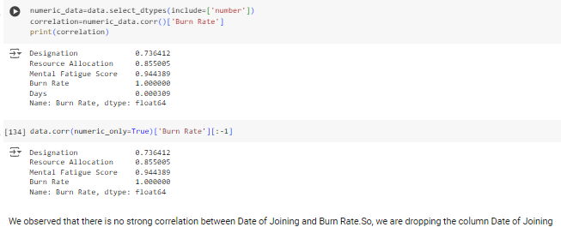
Exploring Data analysis:
Using correlation analysis to select the best features from the data frame for predicting the target variable (Burn Rate).

Slide 13
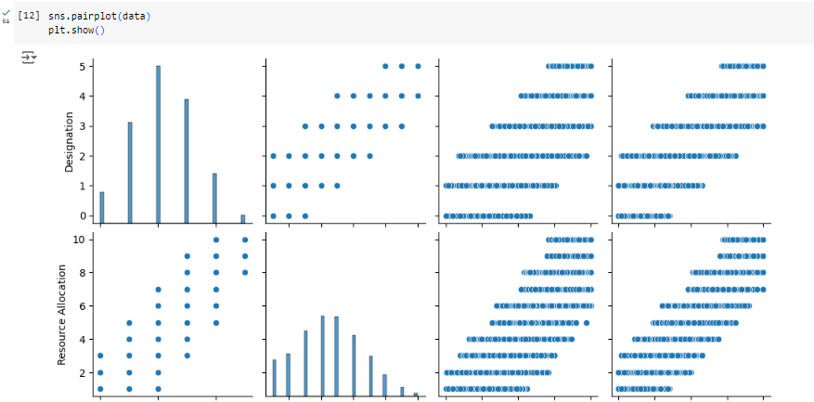

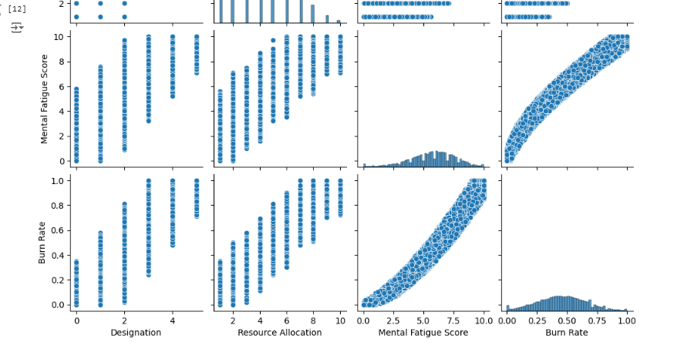


Slide 14
How did you customize your project and make it your own:
In this project, I customized several components to align with my goals. I focused on managing outliers and experimented with different scaling methods to enhance the performance of the linear regression model. Utilizing both MinMaxScaler and StandardScaler significantly impacted the model's performance. I evaluated metrics such as Mean Squared Error (MSE), Root Mean Squared Error (RMSE), Mean Absolute Error (MAE), and R-squared (R²) values. Additionally, I adjusted the correlation analysis to better understand the relationships between variables, including incorporating and examining outliers in the data. This approach allowed me to assess the model's robustness and its response to anomalous data points. These modifications helped me fine-tune the linear regression model, resulting in more accurate and reliable predictions.

Slide 15
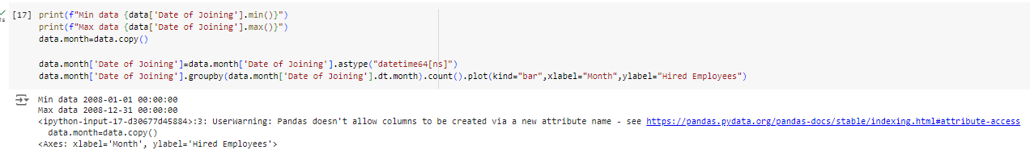
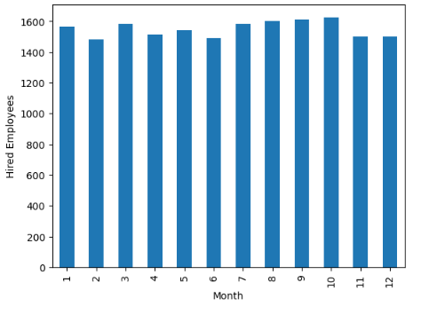
The bar graph displays the count of employees hired each month. The x-axis represents the months of the year, while the y-axis shows the number of employees hired. This visualization helps identify the hiring trends across different months, highlighting the periods with higher or lower recruitment activity.

Slide 16
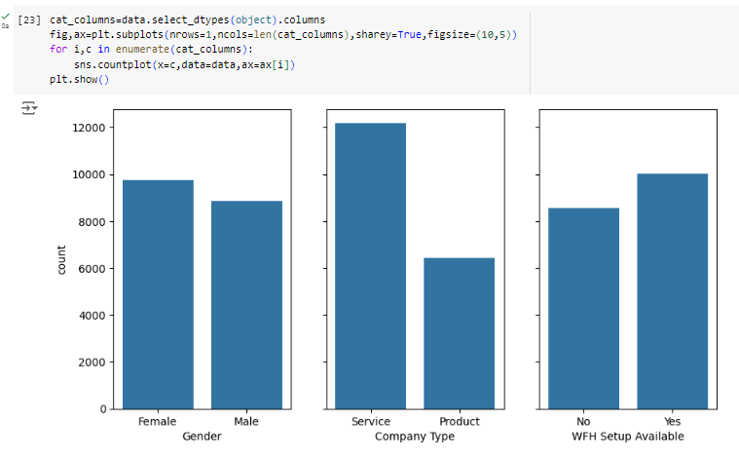
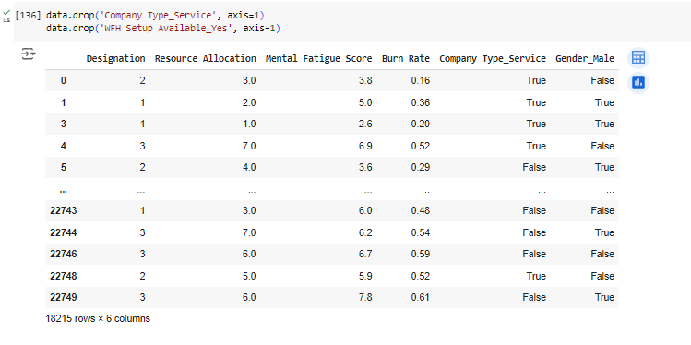
The count plots show the distribution of categorical variables in the dataset. Each subplot represents a different categorical column, illustrating the frequency of each category, allowing for easy comparison across variables.

Slide 17

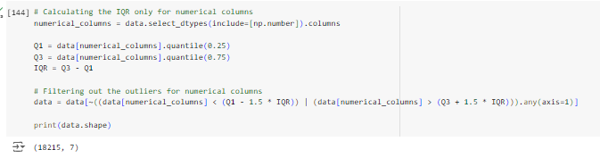
Initial Dataset
Final Dataset after outlier

Slide 18
Linear Regression:
Linear Regression is a powerful statistical technique to model the relationship between a dependent
variable and one or more independent variables.
It is widely applied to understand and predict outcomes in various fields, including economics, finance,
and healthcare.
Example: House Price Prediction
Inputs: Features of the house, such as size, number of bedrooms, location, age, etc.
Output: Predicted price of the house (continuous value).
Equation: y = β0+β1x1+β2 x2+ … +βn xn + e
Y is dependent variable(Burn rate) , β0 is intercept, e is error rate
β1, β2, β3,…., βn are the coefficients that represent the change in y for a one-unit change in the
respective x variable.

Slide 19
The formula for linear regression is used to model the relationship between a dependent variable 𝑦y and one or more independent variables 𝑥x. In the case of a single independent variable (simple linear regression), the formula is:
𝑦=𝛽0+𝛽1𝑥+𝜖
where:
y is the dependent variable (the output or target variable).
𝑥 is the independent variable (the input feature).
𝛽0 is the intercept (the value of 𝑦y when 𝑥x is 0).
𝛽1​ is the slope (the change in 𝑦y for a one-unit change in 𝑥x).
𝜖ϵ is the error term (the difference between the predicted value and the actual value).In the case of multiple independent variables (multiple linear regression), the formula generalizes to:
𝑦=𝛽0+𝛽1𝑥1+𝛽2𝑥2+⋯+𝛽𝑝𝑥𝑝+𝜖
where:
𝑥1,𝑥2,…,𝑥𝑝x 1​ ,x 2​ ,…,x p​ are the independent variables (features).
𝛽1,𝛽2,…,𝛽𝑝β 1​ ,β 2​ ,…,β p​ are the coefficients (weights) for each independent variable
.𝛽0β 0​ is the intercept.𝜖ϵ is the error term.

Slide 20
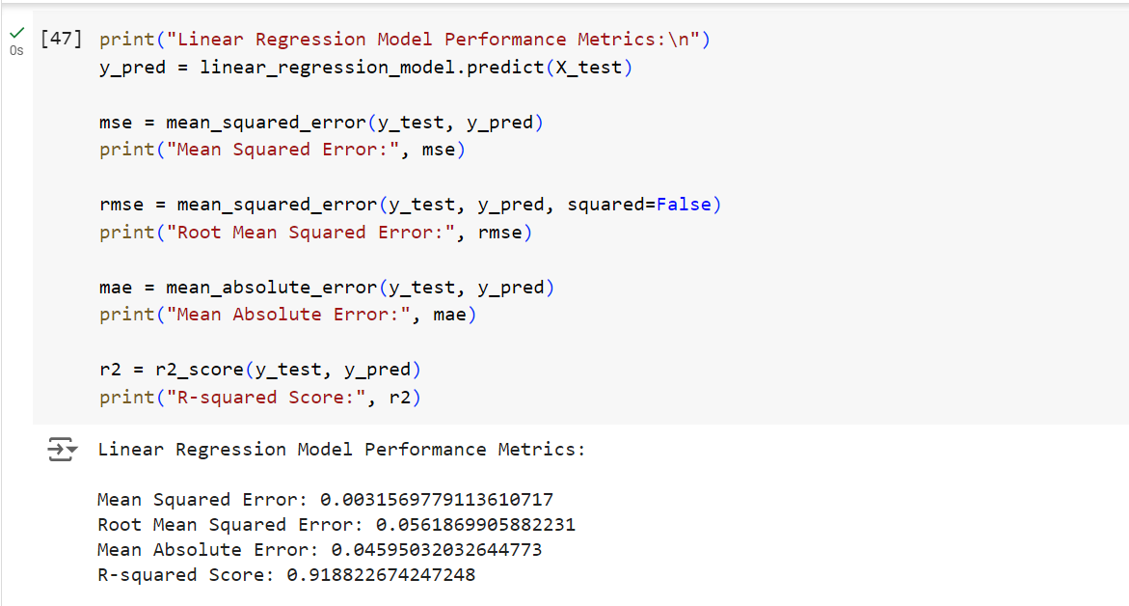
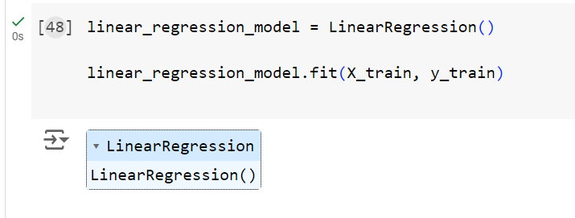
Results
MSE and RMSE: These values suggest that the model's predictions are fairly accurate, with an average squared error of 0.00315 and an average prediction error of 0.0561.
MAE: The model's average absolute prediction error is 0.045, indicating that, on average, predictions are off by this amount.
R-squared (R²): With a value of 0.918, the model explains 91% of the variance in the burnout risk, indicating a strong relationship between the predictors and the target variable.

Slide 21
Conclusion:
The linear regression model effectively predicts employee burnout risk with reasonable accuracy. Insights from this model can be utilized by HR professionals, managers, and organizational leaders to proactively address employee burnout. This can enhance employee well-being, job satisfaction, and overall organizational productivity. Additionally, it aids in the efficient allocation of resources to support the employees most in need, fostering a healthier and more productive work environment.

Slide 22
LINKS:
Google collab link: https://colab.research.google.com/drive/1AkwYH06eGWESLUhWJz_iJN0gjrpHbJbr
Github Link: https://github.com/ChristoTonio/Employee_burnout_prediction/tree/main
https://www.ibm.com/docs/en/db2oc?topic=procedures-linear-regression

Slide 23
Thank you

